Slide 1

A Partnership of the
Nevada Departments of Education and Public Safety

Slide 2


SafeVoice Anonymous Tip Reporting Now Available
SafeVoice is an anonymous place where students can report threats to their safety or their fellow students’ safety.
Report concerns about your friends, or yourself, anytime any day.
SafeVoice app
Call 833-216-7233(SAFE)
www.safevoicenv.org
Notes:
Teacher encourages students to take out their phones.
When you file a report, your name, phone number or IP address is not attached, it is completely anonymous and confidential, so you don’t have to worry about anyone knowing you’ve let SafeVoice know about your concerns.

Slide 3
Why SafeVoice?
What happens around here and in your life that would be helpful to be able to report?
Your voice can be the difference.
Notes:
Teacher leads discussion with students making sure to touch on student well-being, disrespecting of school, potential school violence
Discussion incorporates students taking responsibility for their friends’ well-being and for school climate. Encouraging students to be upstanders.

Slide 4

When to Use SafeVoice
To support your friends when they are facing
Bullying at school or online
Suicidal thoughts or self-harm
Sexual harassment
Substance abuse
OR, if you are aware of violence or weapons at your school
In the vast majority of shootings at schools, someone knew the shooter was involved with guns, but didn’t tell an adult
Notes:
Discuss how bullying can happen in and out of school and online
Discuss how SafeVoice also extends to additional behaviors like any type of abusive relationships, harmful situations, concern for friends or classmates.

Slide 5

Telling vs. Gossiping
Telling
Gossiping
Keeping school safe
Someone could be harmed or even lose their life
Problem is urgent and important
An adult can help solve the problem
Perception that something is gained from the gossip
Feelings are hurt
Avoiding Blame
Problem is passed on, not solved
Notes:
Discuss the difference between telling and gossiping and how telling is important and the purpose of SafeVoice.

Slide 6

SafeVoice is for students who need help
The SafeVoice program is anonymous
When a student contacts SafeVoice with a concern it will ALWAYS be taken seriously and responded to by trained professionals
Reports are received live 24/7/365
Notes:
Students who intend to abuse the SafeVoice program will be tying up the lines for someone who wants to use the program correctly. Use it for serious concerns. Show it respect, it was created to protect you.

Slide 7
Who receives the
SafeVoice Reports?
Law enforcement is engaged immediately for ‘911’ situations
A team here at your school of administrators and counselors receives the reports multiple times a day and will start taking appropriate actions to intervene and support
You won’t hear directly about the response because reporting is anonymous, but you can feel better knowing you stood up for a friend

Slide 8
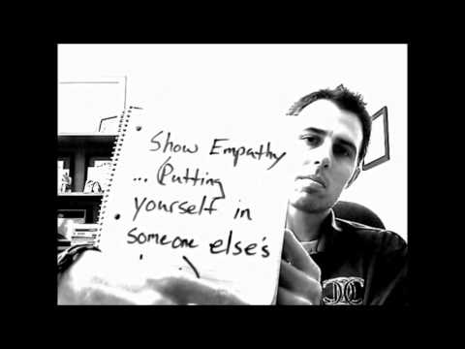

But, why?
Be Courageous. Be the Change.
Notes:
Teachers please note you will need internet connection to play this video
If you cannot click on video and play it, you can find at link here: https://goo.gl/images/p7f2vk
Flag on video: This is a moving video from our partner Assistant Principal David King. It refers to Safe2Tell, which is our partner program in Colorado. Assure students that in Nevada it is Safe to Tell an adult using SafeVoice.
After the video ask your students, if they noticed the small error? You can point out that this said to use Safe2Tell and we are asking them to use SafeVoice. No matter where you are or how you do it, we can all keep each other safe by being an upstander.

Slide 9

So… Hey Students, Take Out Your Cell Phones
And 1,2,3….Download.
Be ready to protect a friend, your school, or yourself
Call 833-216-SAFE (7233)
www.safevoicenv.org
Notes:
Start with question: What are some times it is important to speak up for your friends?
Teacher read discussion guide

